Slide 1

Analyzing the Stability of Compact Finite Difference Schemes for Use in Binary Black Hole Simulations
Nathanael Garey¹, Eric Hirschmann¹, David Neilsen¹, James Bleazard¹, Luke Papenfuss¹, Andrew Carroll¹
¹Brigham Young University, Provo, UT 84602

Slide 2
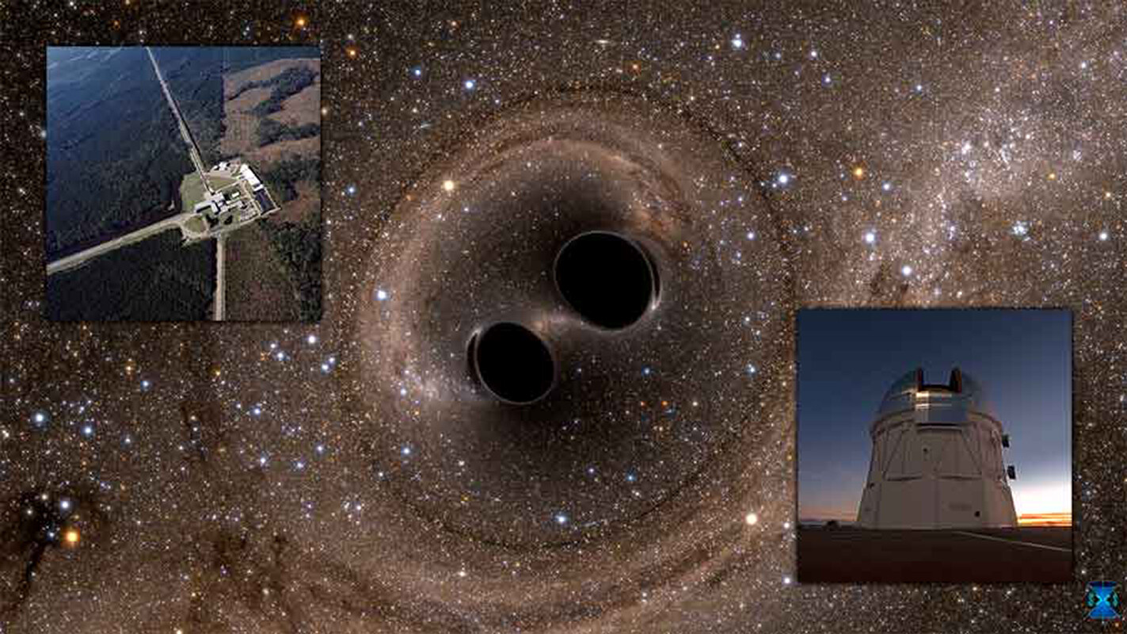
Purpose/Goals
Fast and accurate black hole mergers are needed
Additional factors (high mass ratio, spin, eccentricity) increase computational costs
Most current methods to improve accuracy/speed are not stable
https://commons.wikimedia.org/wiki/File:Gravitational_waves_detected_100_years_after_Einstein%E2%80%99s_prediction_%28noaoann16005a%29.jpg
Notes:
Want to model GW faster and with high accuracy.
Important/relevant with new projects like LISA.
Difficult challenge to employ methods that improve accuracy but are stable.

Slide 3
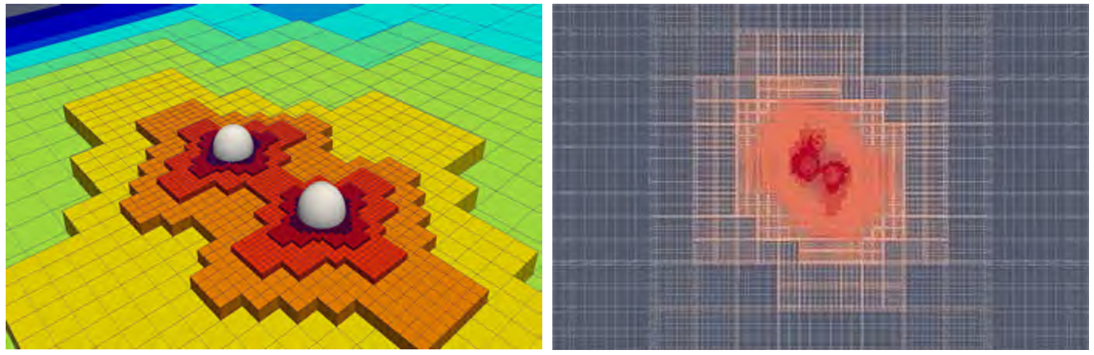
Dendro-GR
Binary black hole simulations with Wave Adaptive Mesh Refinement (WAMR)
Less refinement needed in the grid where information hasn’t propagated
Plan to implement stable 2nd derivative compact schemes once they are found
Massively Parallel Simulations of Binary Black Hole Intermediate-Mass-Ratio Inspirals (Fernando et al.)
Notes:
The codebase that runs binary merger simulations.
WAMR saves on computational time.
When we find the stable schemes, we will implement them into Dendro.

Slide 4
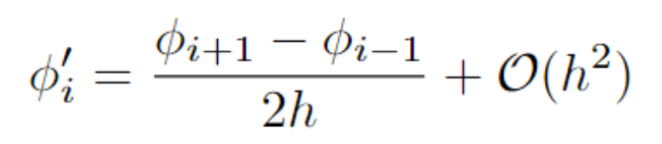
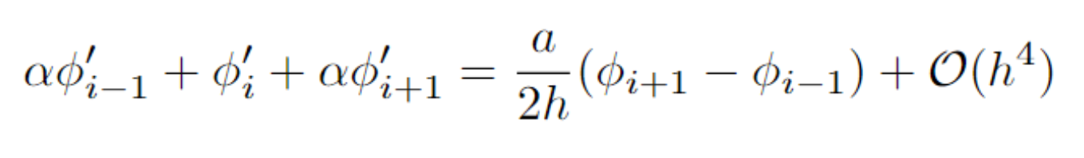
Explicit vs. Compact Schemes
Compact Finite Difference (CFD) schemes can achieve higher accuracy with less points.
The matrix inversion is an additional computational cost.
It is more difficult to find stable compact schemes.
Explicit Scheme
Compact Scheme
Notes:
CFD comes with additional difficulties that we are addressing (matrix inversion, harder to find stability).
There are fast methods to invert banded matrices.
The improvement from using less points is worth introducing the additional complications.

Slide 5
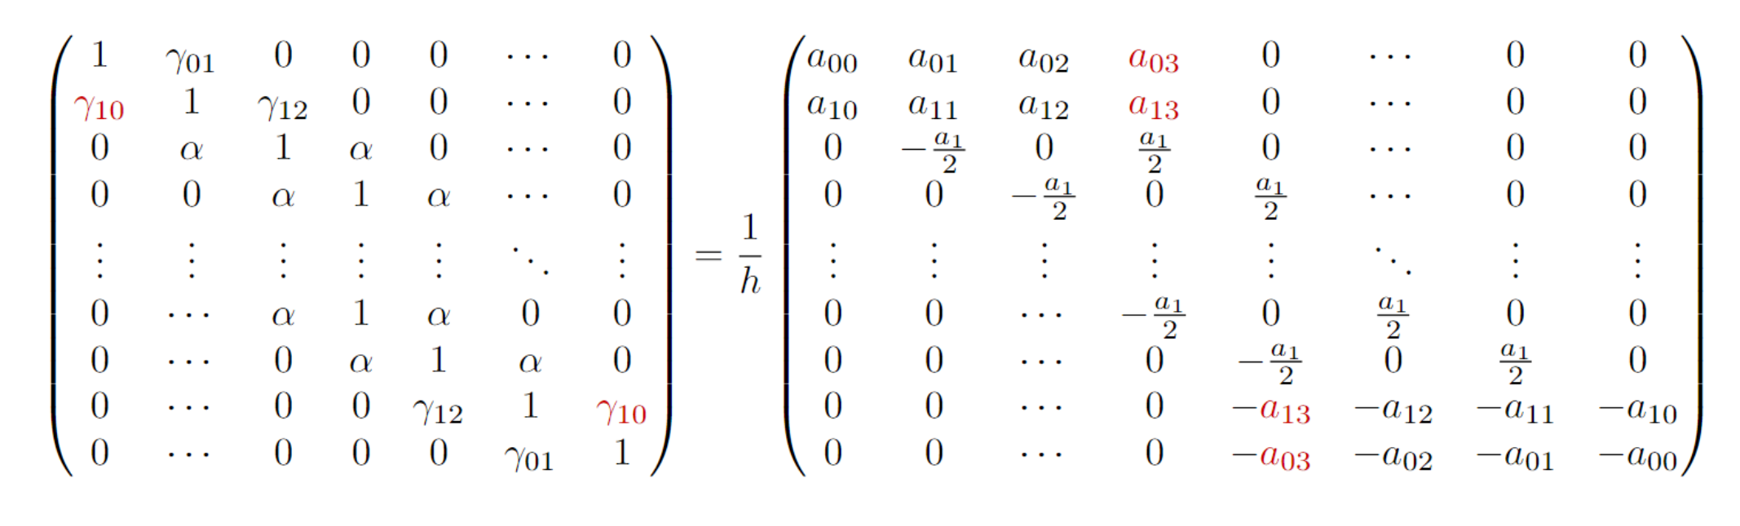
Improving Stability
Start with a CFD with Dirichlet boundary conditions
Add free parameters that can vary from their “original” value
Run many tests with different free parameters and eliminate options that become unstable
Notes:
Brady and Livescu did this for 1st derivatives, our goal is to do this for 2nd derivatives.

Slide 6
Improving Accuracy
Boundary points have worse accuracy than interiors
Centered vs. shifted stencils – less points to approximate the function’s derivative
Interpolation function allows boundary points to use information from “points” outside the scheme, acting like a centered stencil
Notes:
Kim approach – interpolation function to almost treat boundaries as centered stencils

Slide 7

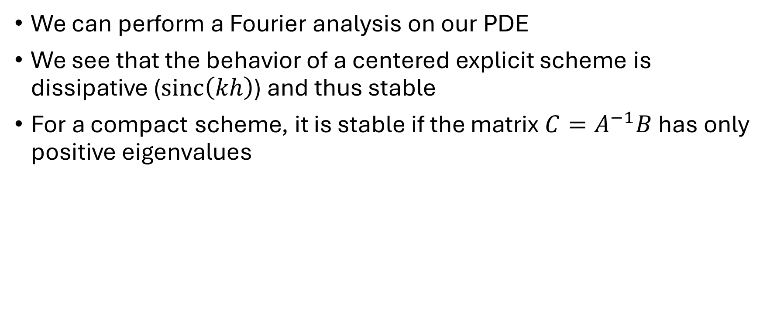
Analytic Approach
We can perform a Fourier analysis on our PDE
We see that the behavior of a centered explicit scheme is dissipative ($sinc\left(kh\right)$) and thus stable
For a compact scheme, it is stable if the matrix $C=A^{−1}B$ has only positive eigenvalues
$$u_{t}=a⋅u_{x}$$
$$u_{t}=\frac{a}{2h}\left(u_{i+1}−u_{i−1}\right)$$
$$\tilde{u}\left(t,k\right)=\frac{1}{\sqrt{2π}}\int{e^{−ikx}u\left(t,x\right) dx}$$
$${\tilde{u}}_{t}=\frac{a}{2h}⋅2i\sin\left(kh\right)⋅\tilde{u}$$
$${\tilde{u}}_{t}=\left(ika⋅\frac{\sin\left(kh\right)}{kh}\right)\tilde{u}$$
$${\tilde{u}}_{t}=a^{′}\tilde{u}$$

Slide 8
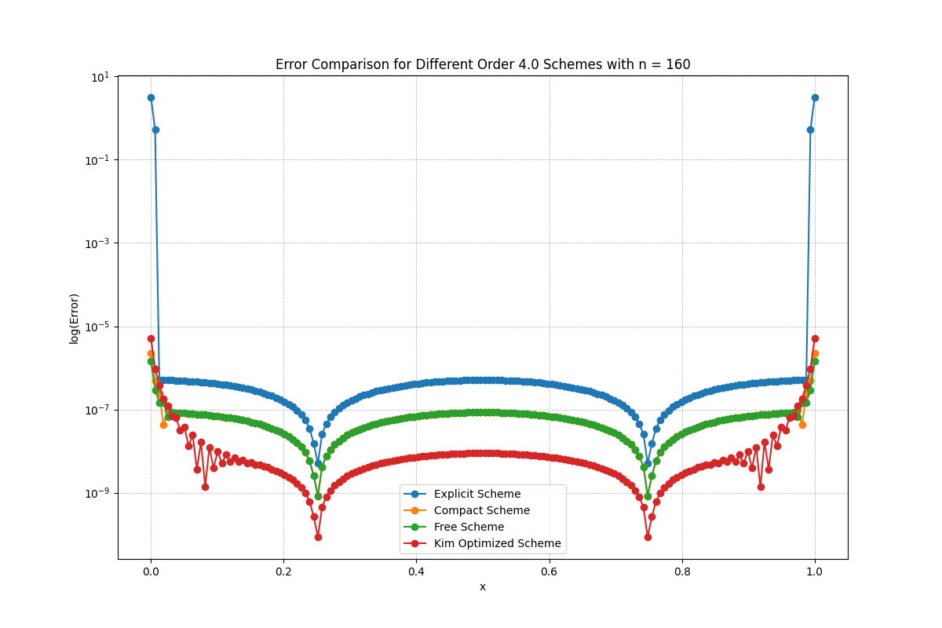
Towards a genuinely stable boundary closure for pentadiagonal compact finite difference schemes (Kim et al.)

Slide 9
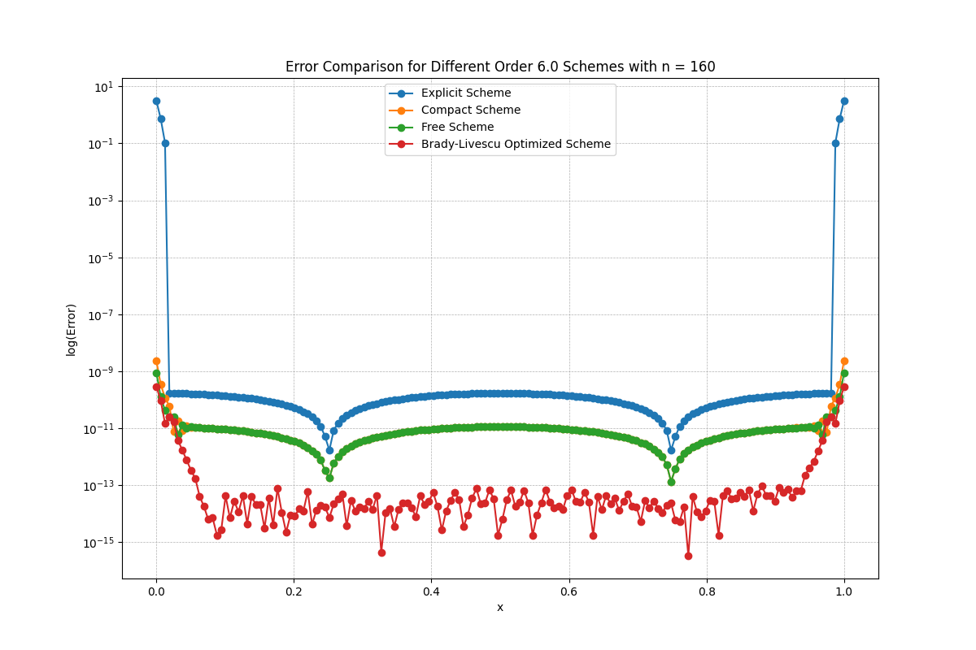
High-order, stable, and conservative boundary schemes for central and compact finite differences (Brady and Livescu)

Slide 11
Future Work
Machine learning optimization algorithm to find parameters for stable 2nd derivative operators
Boundary interpolation methods to improve accuracy on boundary points
Analytic work to show schemes that are stable

